Slide 1
Smart Lectern
Introduction
Drake Nong
2023 Aug.

Slide 2



Design & Function Introduction
Core Selling Points & Use Scenarios
Solutions

Slide 3

Design & Function Introduction

Slide 4

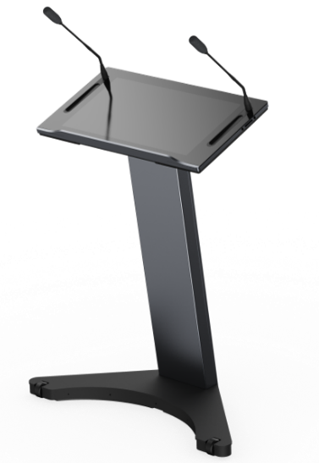
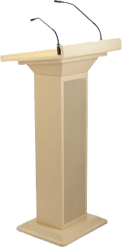
Design Concept
Smart Lectern, solving pain points such as messy wiring, forgetting speeches, and inconvenient interaction with traditional podiums. At the same time, the stylish design, Electric lift, and wireless screen sharing bring a brand new speaking experience for speakers.
.
Traditional Lectern | MAXHUB Smart Lectern
The appearance is simple, traditional, and bulky. | The appearance is business-like, concise, and fashionable, with a sense of technology.
Need to use an external computer, unable to write by touch | Built-in Windows system, touch and writing.
Separate power cord, audio cable, and network cable are required for use. The cables are messy. | Integrated wireless design (for power, Ethernet cable, etc.)
Externel microphone is required. | Integrated detachable microphone
Fixed height | Electrical lift control
Inconvenient to move | Mobile wheels for convenient movement.

Slide 5
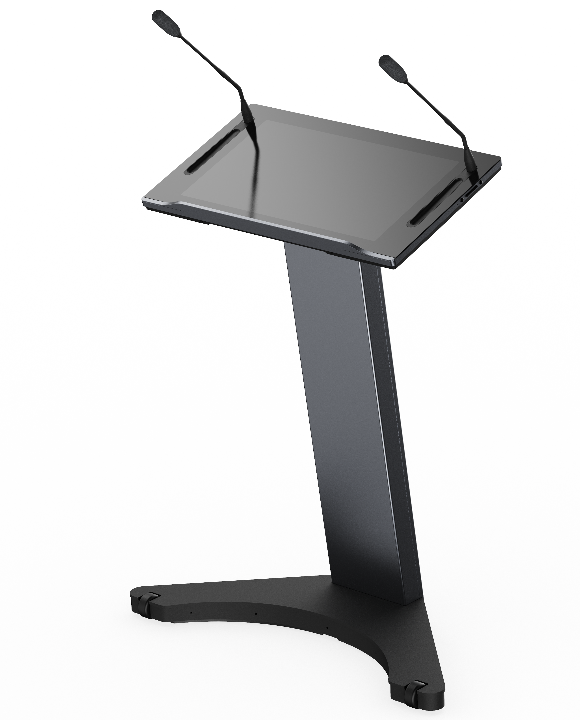
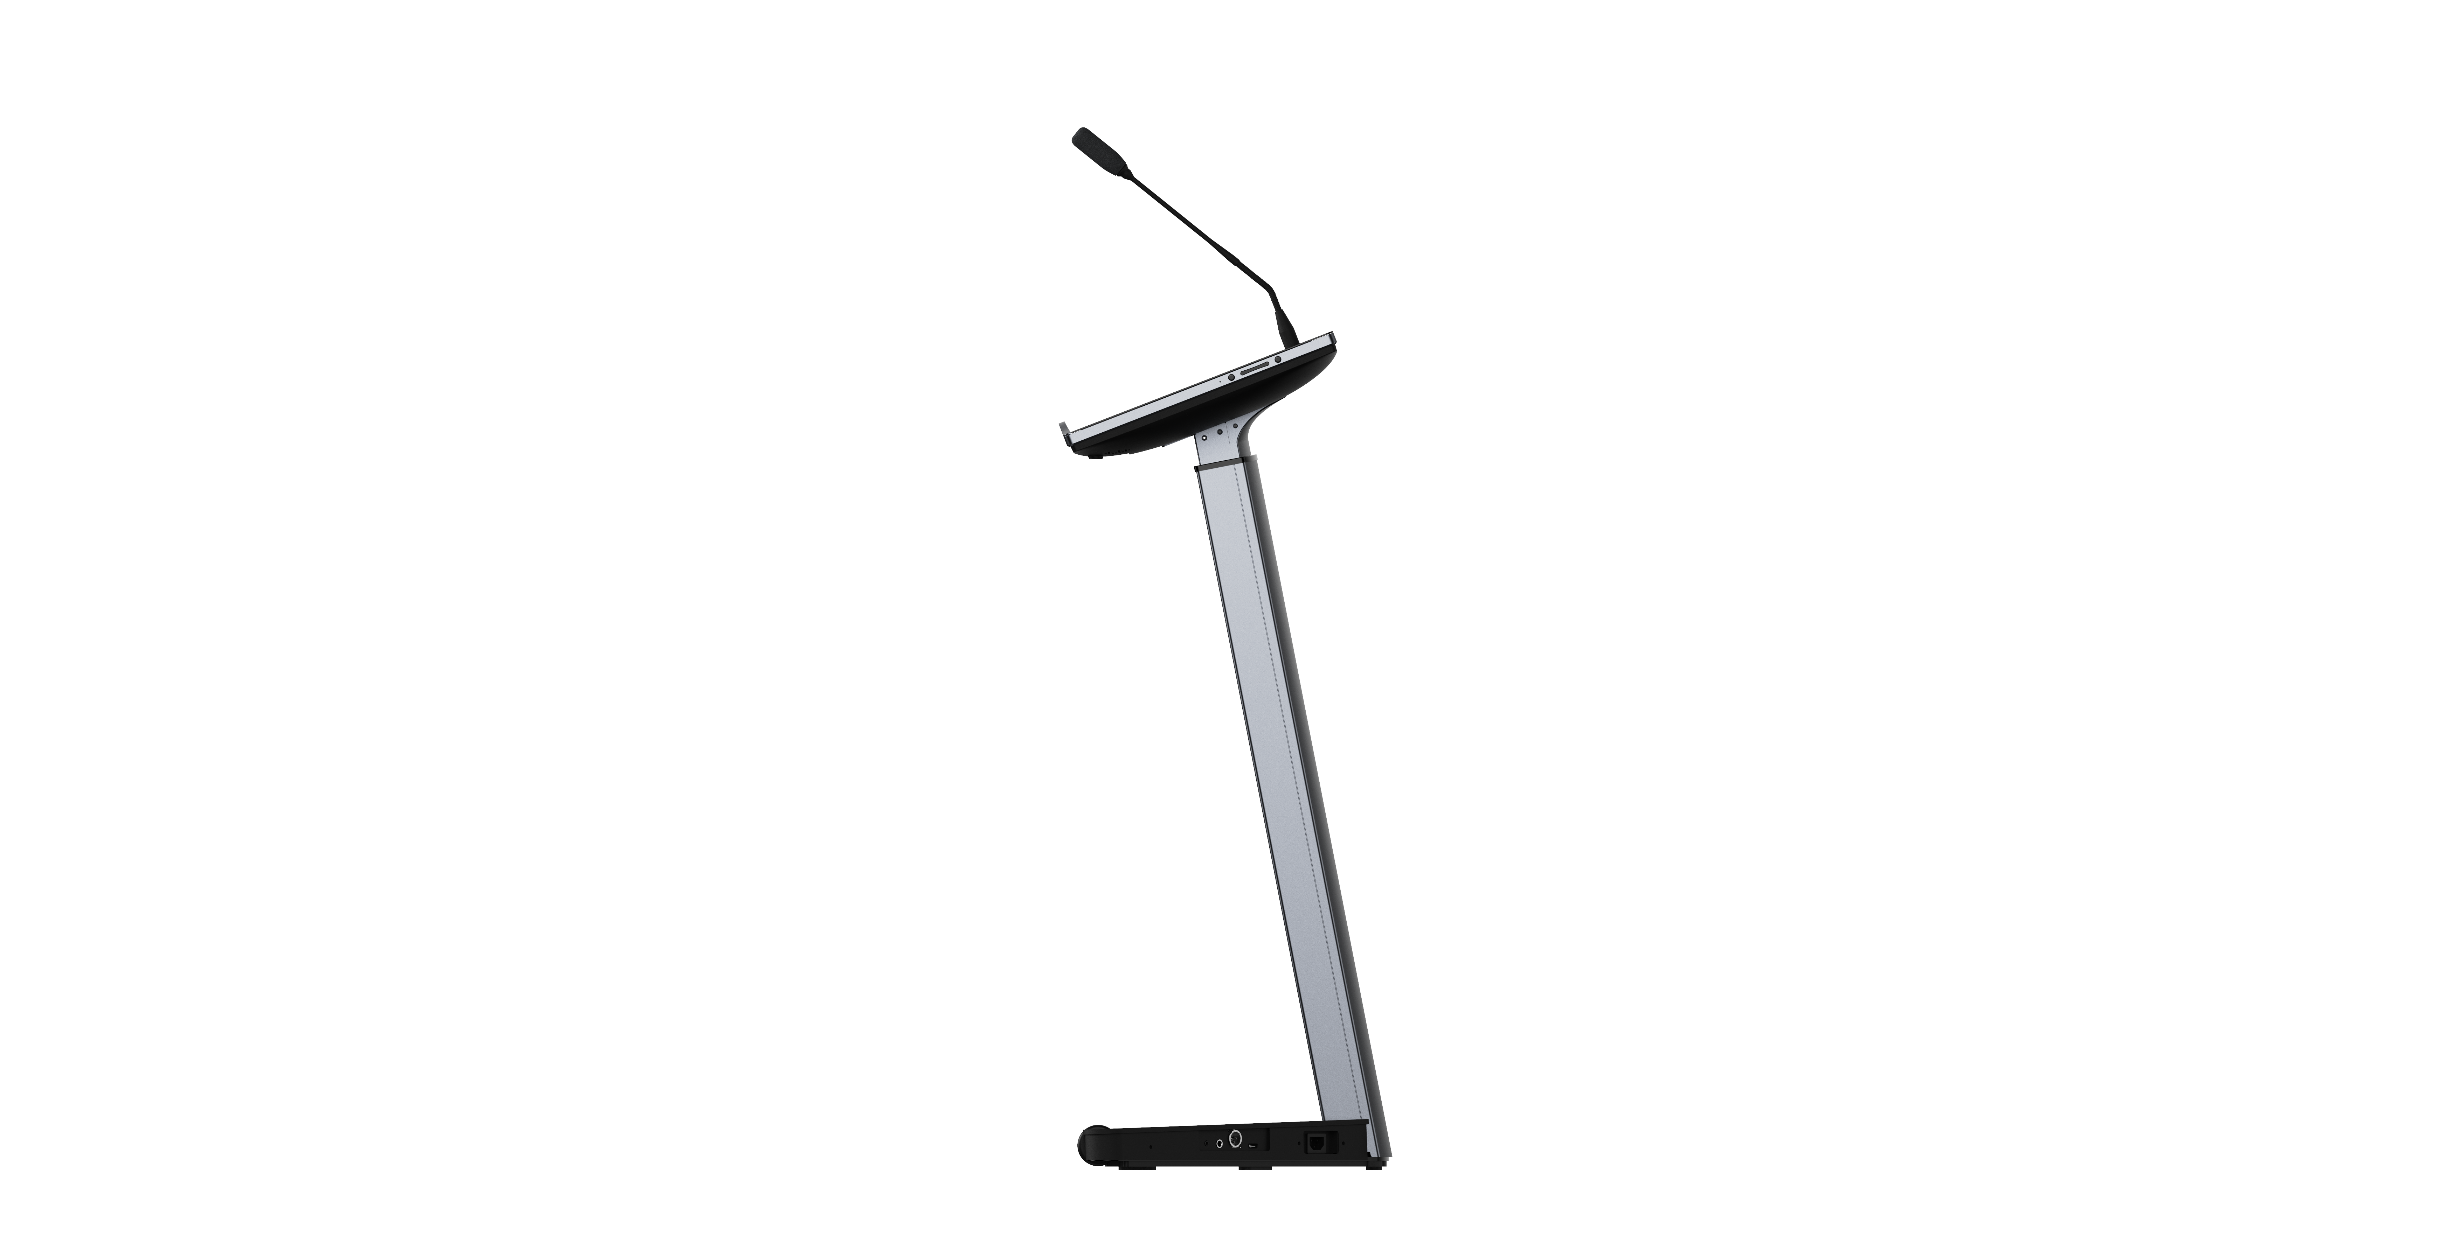
Product Function Introduction
- Note：Red is the upgraded feature
Gooseneck Microphone
The pickup range is 30cm, microphone length 45cm.
Intelligent recognition of Main and side mic
USB2.0*2
21.5-inch touch display unit
OCA full lamination
Active capacitive screen touch technology
CPU upgrade, performance increased by nearly 4 times
Pen slots on both sides, for placing capacitive pens.
Power button
Lifting button
Wi-Fi Module
Wireless module upgrade, screen sharing performance improvement.
Mute button
Electric lifting column, adjustable range 1.0~1.2m
HDMI OUT*1
AC*1
Cannon*1
Lectern chassis unit
Ergonomic Design for Human Body Curve
Integrated Multi-functional Audio Output Interface
AUDIO OUT(6.5)*1
AUDIO OUT(3.5)*1

Slide 6
Core Selling Points & Use Scenarios

Slide 7
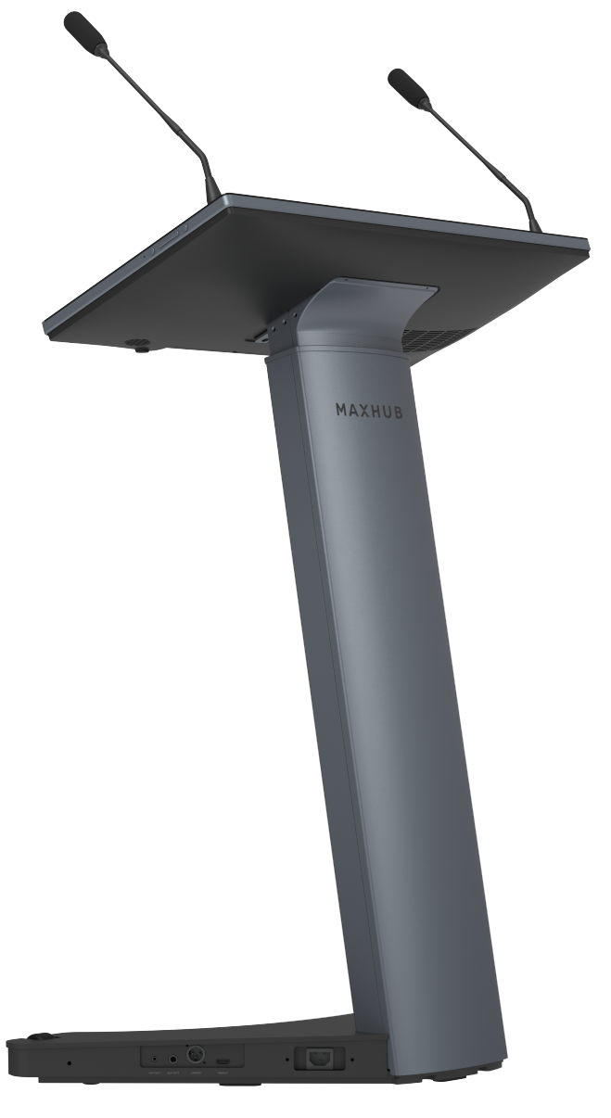
Core Selling Points
Fashion ID
Simple, business, and technological appearance design
Deep gray sandblasting oxidation process, showing a capable and steady temperament
Extremely clear display
2K high-definition display screen, clear picture quality
Up to 450nit high brightness display, easily cope with strong light environments
Adopt full lamination technology to effectively reduce light reflection and improve display effect
Various Bundle options
Multiple types of audio interfaces for convenient peripheral device connection
HDMI OUT interface for easier expansion of displays

Slide 8
Core Selling Points
Wireless Screen Sharing
Support MAXHUB Share, content sharing becomes easier
High-end Presentation Tool
Intelligent main and secondary gooseneck microphones, freeing your hands
Expand screen sharing, replacing the prompter, real-time viewing of notes, solving the pain point of forgetting the script
Real-time Annotation
Real-time interactive annotation, active capacitive touch control, optimizing writing effect
Electric Height Adjustment
Electric stepless height adjustment, suitable for different speakers' heights
One-click lifting, simple and fast
Easy to Move
Hidden dual movable wheel design, easy to move by one person, freely change positions

Slide 9

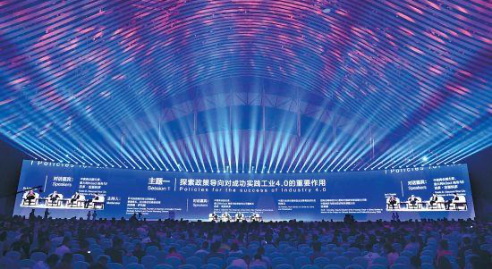
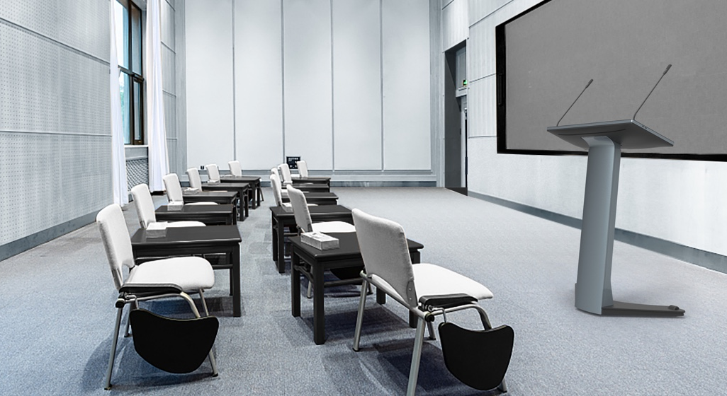
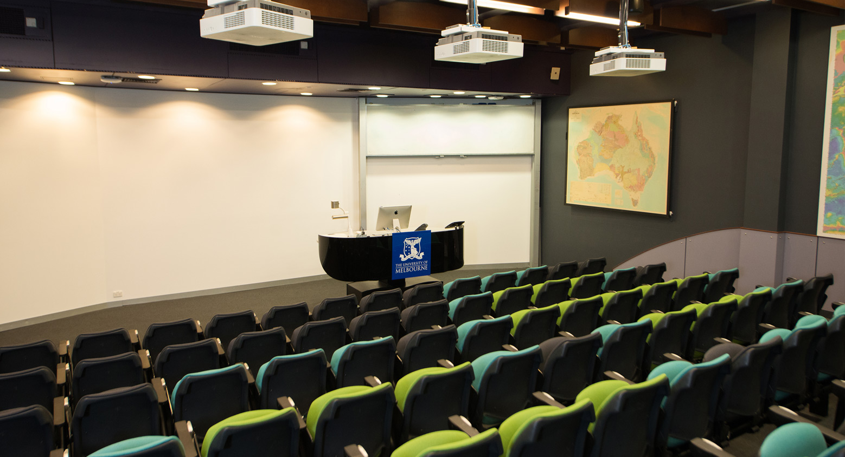
Use Scenarios
Where to place your smart lectern
Exhibition / Forum
Large training room / Classroom
Auditorium / Lecture hall

Slide 10
Solutions

Slide 11
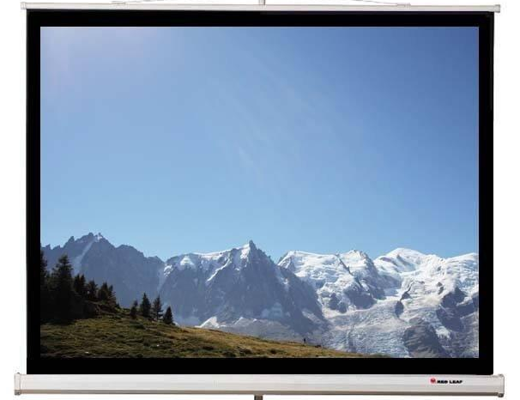
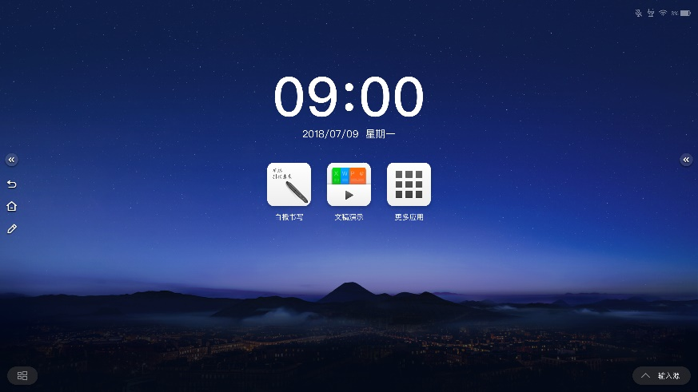
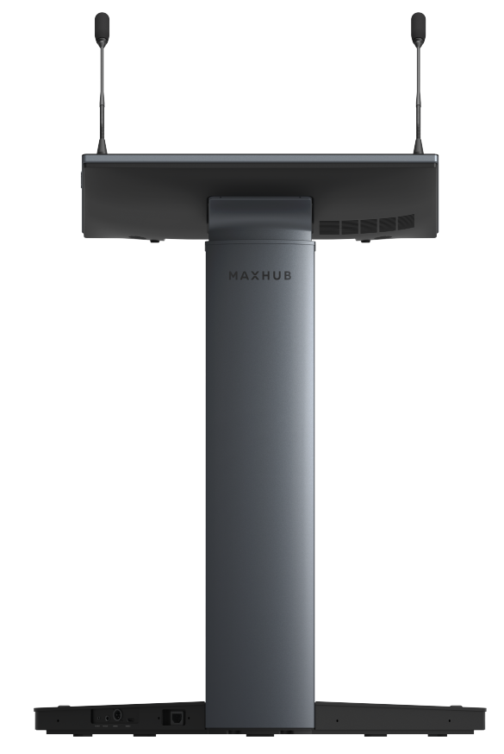
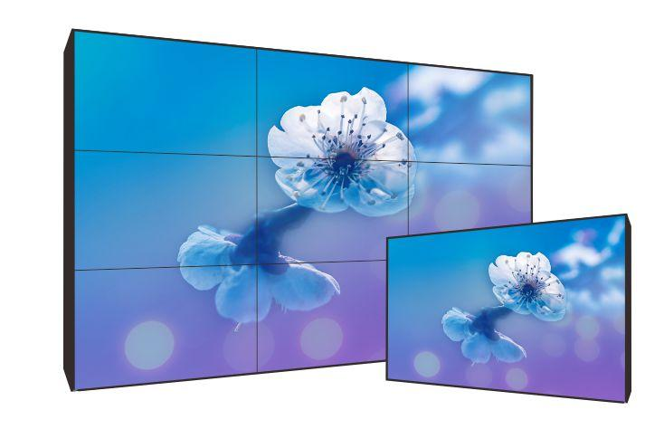

Presentation solution
Projection
+
=
LCD
Sleek and stylish design
Win10 operating system
Wireless screen sharing, interactive between large and small screens
Annotations
Prompter
LED
Smart Lectern
Display
Intelligent Speech Presentation

Slide 12
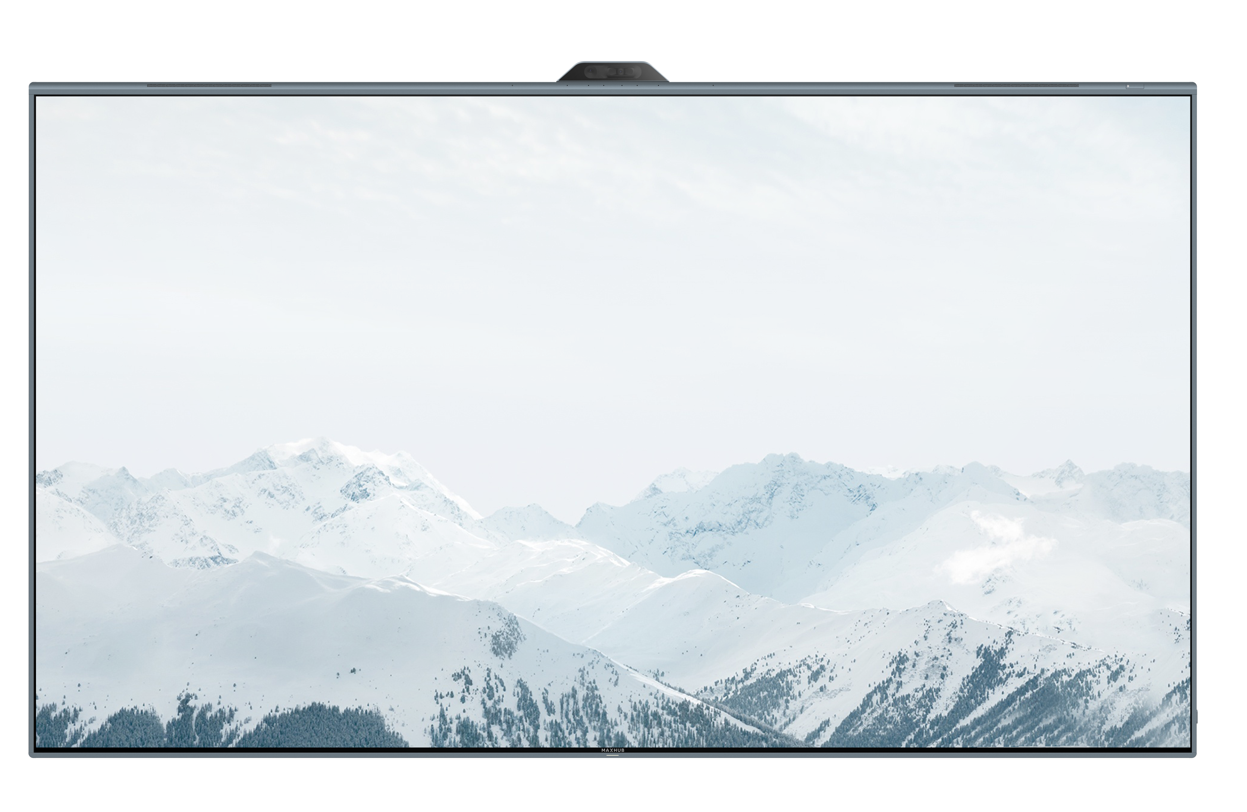
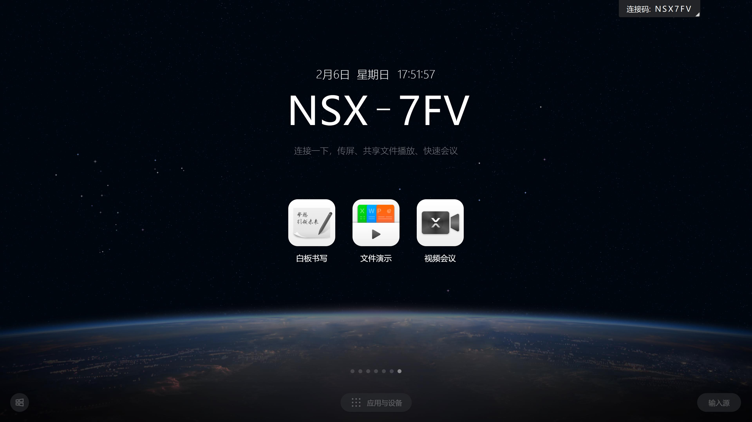
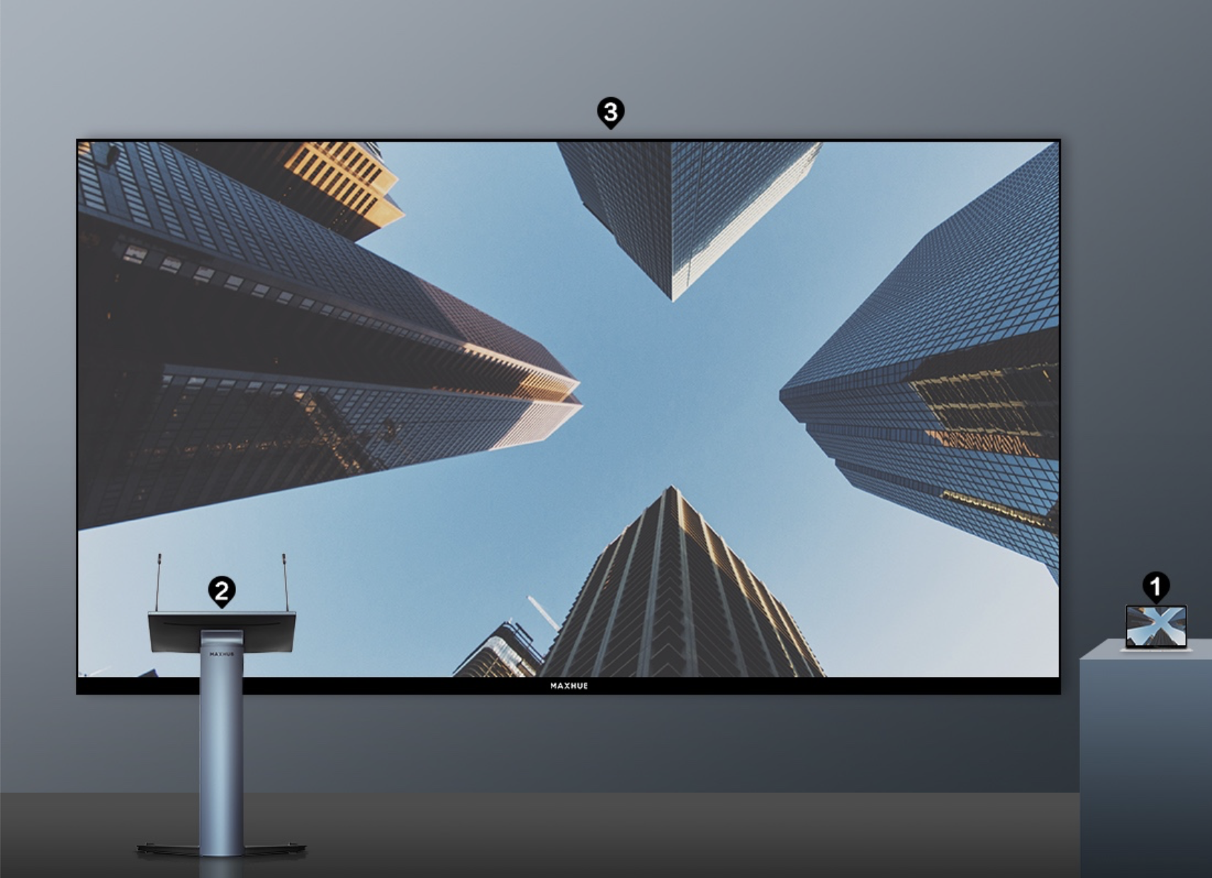
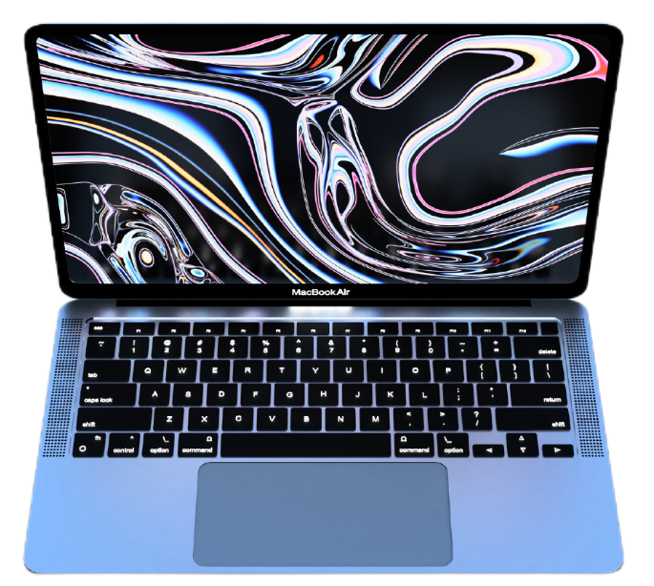
Wireless Screen Sharing Solution
Hotspot
Same local area network
PC
Smart Lectern
MAXHUB
Display
Maxhub Share
Maxhub WT13
Lectern connect Hotspot and share through built-in screen share software
Screen share
MAXHUB Share/WT13

Slide 13
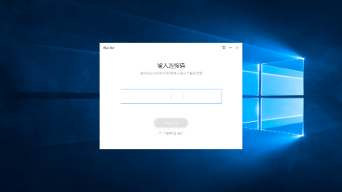
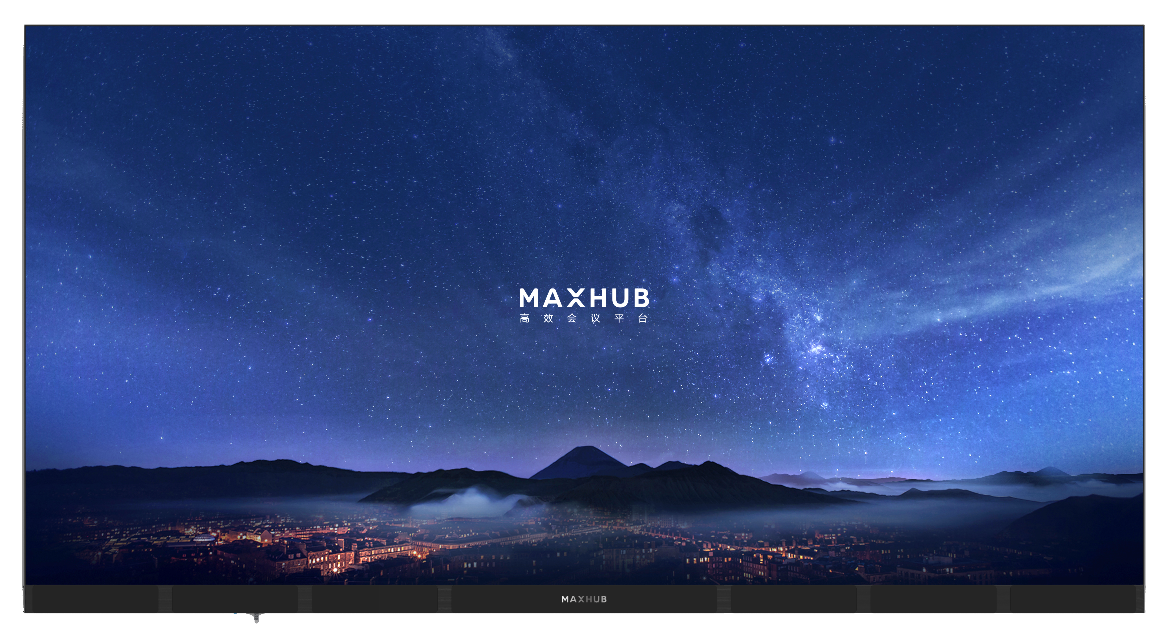
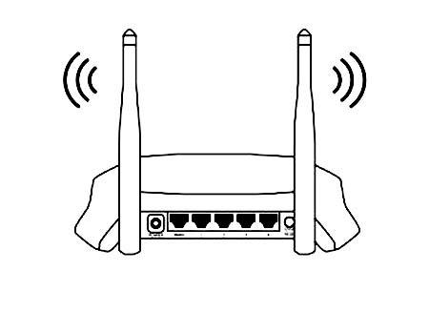
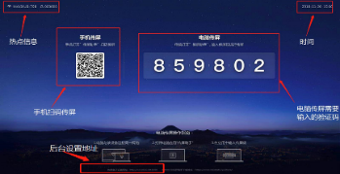
LED integrated terminal Solution
Lectern screen share software
LAN
Smart Lectern
MAXHUB All-in-one LED Raptor Series
Screen share code
MAXHUB integrated display terminal and the lectern are in the same local area network
Through the built-in screen share software in the lectern, input the screen sharing code of the MAXHUB integrated display terminal to wirelessly share the screen.
The lectern can also be directly connected to the MAXHUB integrated display terminal via an HDMI cable.
Note：
The MAXHUB integrated LED display terminal does not support touch
HDMI cables typically support transmission distances of up to 5 meters. If you need to extend the distance, additional extension devices are required.
It is recommended to purchase HDMI extension devices or accessories from reputable brands.

Slide 14
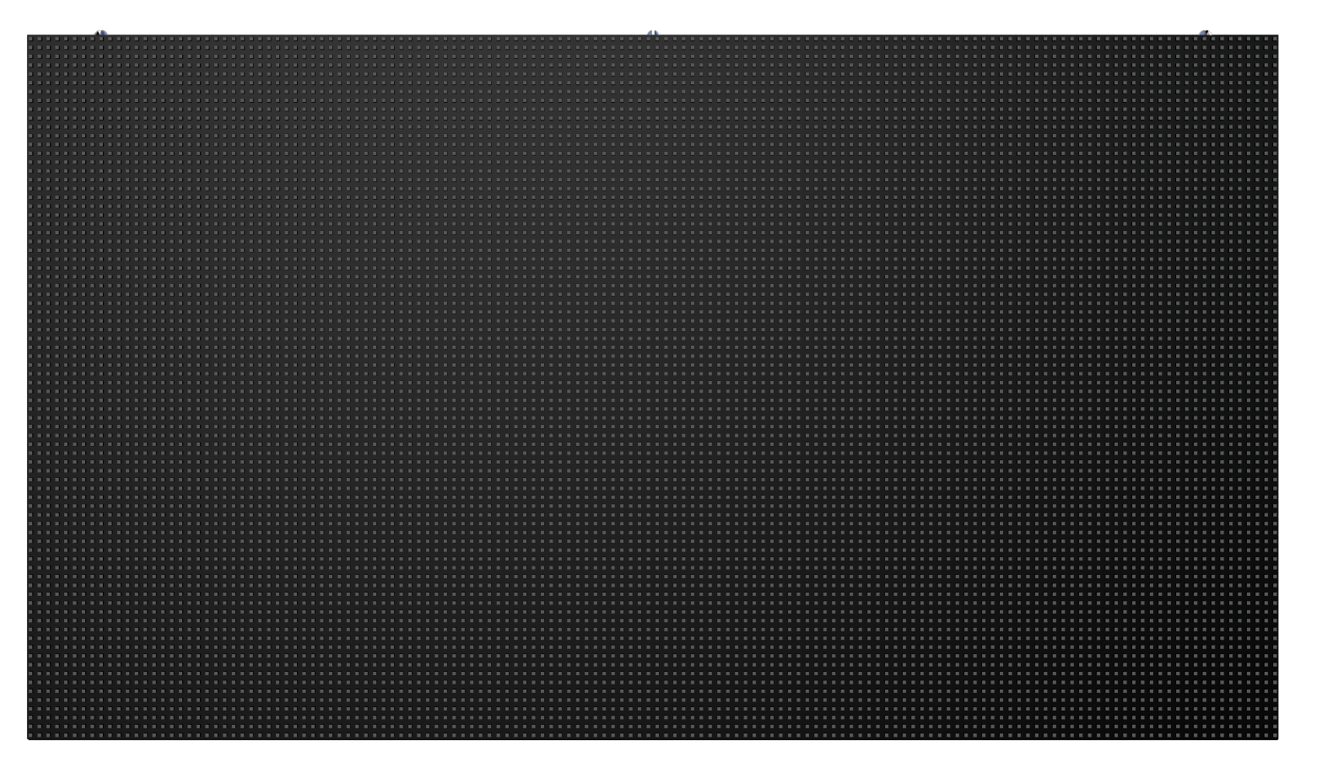
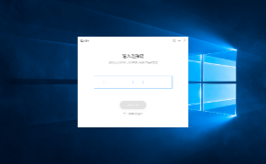
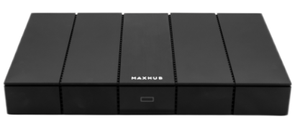

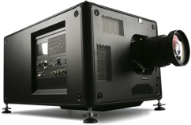
Traditional display Solutions
Lectern screen share software
HDMI OUT
HDMI IN
Third-party LED Display
Lan/Hotspot
WB05
MAXHUB
Smart Lectern
Screen share code
Third-party Projection
WB05 and the lectern are in the same local area network
Through the built-in Lectern screen share software in the lectern, input the screen sharing code of the WB05 to wirelessly share the scree；
WB05 Connect to the third-party device through HDMI
Note：
The third-party device does not support touch
HDMI cables typically support transmission distances of up to 5 meters. If you need to extend the distance, additional extension devices are required.
It is recommended to purchase HDMI extension devices or accessories from reputable brands.

Slide 15
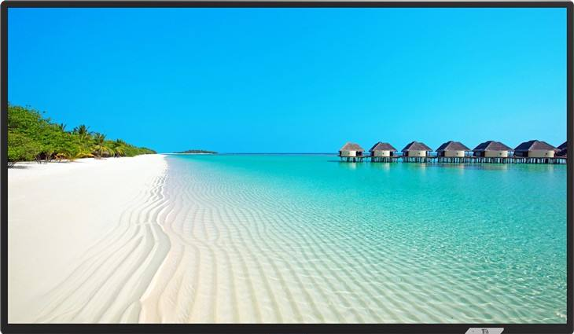

Multiple Device Solutions
Sender
Ethernet cable
Receiver
HDMI线
HDMI IN
HDMI OUT
HDMI IN
Third party display
Lectern screen share software
Sender
Ethernet cable
Receiver
HDMI线
HDMI splitter
HDMI IN
Lan/Hotspot
WB05
Sender
Ethernet cable
Receiver
HDMI线
MAXHUB
Smart Lectern
HDMI IN
Screen Share Code
WB05 and the lectern are in the same local area network；
Through the built-in Lectern screen share software in the lectern, input the screen sharing code of the WB05 to wirelessly share the screen；
The HDMI OUT port of the WB05 is connected to the HDMI IN port of the HDMI splitter through an HDMI cable for output；
The HDMI OUT port of the HDMI splitter is connected to the sender of the HDMI extender；
The sender of the HDMI extender are connected to the sender through an Ethernet cable；
The HDMI receiver is connected to the LED display terminal's HDMI IN port through an HDMI cable.
Third party LED display
Note：
The third-party device does not support touch
HDMI cables typically support transmission distances of up to 5 meters. If you need to extend the distance, additional extension devices are required.
It is recommended to purchase HDMI extension devices or accessories from reputable brands.

Slide 16
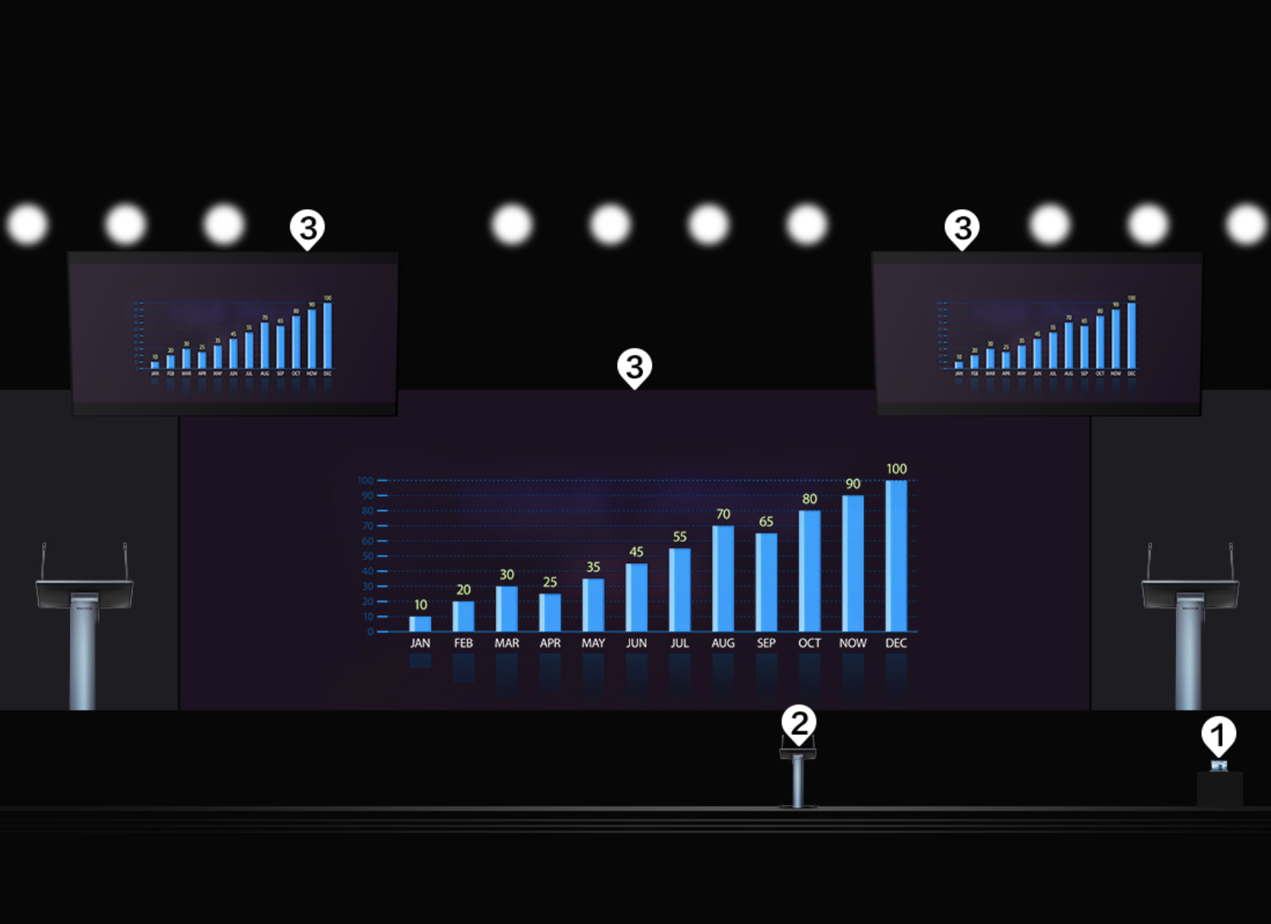
Multiple Device Connection Methods

Slide 17
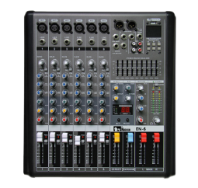
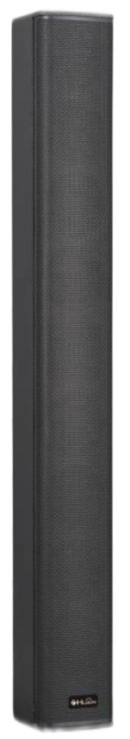
Wired Audio Solutions
Display
HDMI OUT*1
Mixing Console
Cannon*1
AUDIO OUT(6.5)*1
AUDIO OUT(3.5)*1
Note：
For audio cables, it is recommended to choose well-known brands 6.5mm and 3.5mm Cannon cable
HDMI cables typically support transmission distances of up to 5 meters. If you need to extend the distance, additional extension devices are required.
It is recommended to purchase HDMI extension devices or accessories from reputable brands.
Speaker

Slide 18
Upgrade
Spec. Difference between new model & previous model
Spec. | P22MB | SL22MC
Mic Length | 40cm | 45cm
Microphone pickup range | <10cm | <30cm
PC Module | MT42 | OPS72D
CPU | i5-8250U(1.6GHz) | i5-1240P(1.7GHz)
Buiit-in Battery | NO | NO

Slide 19
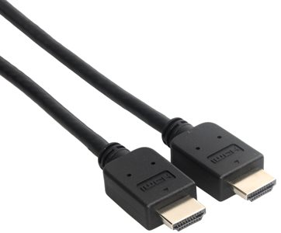
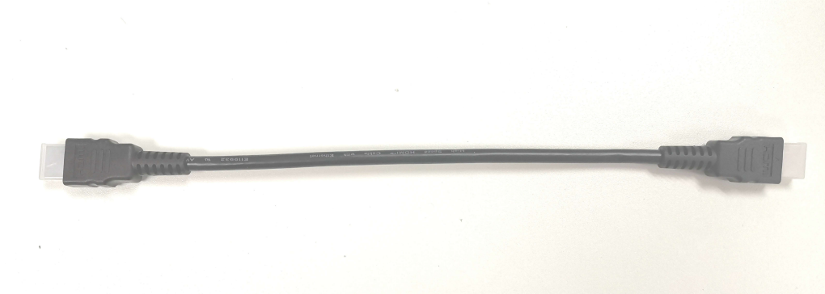
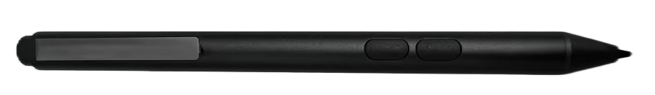
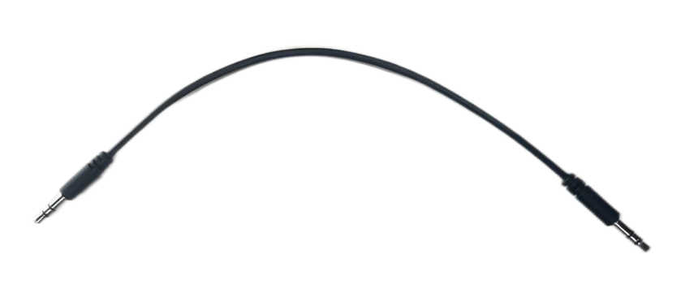
What’s in the box
Cables x4
Power Cord x1
HDMI Cable (3m) x1
HDMI Adapter Cable x1
Headphone Adapter Cable x1
SP28-M x1
Gooseneck Microphone x2

Slide 20
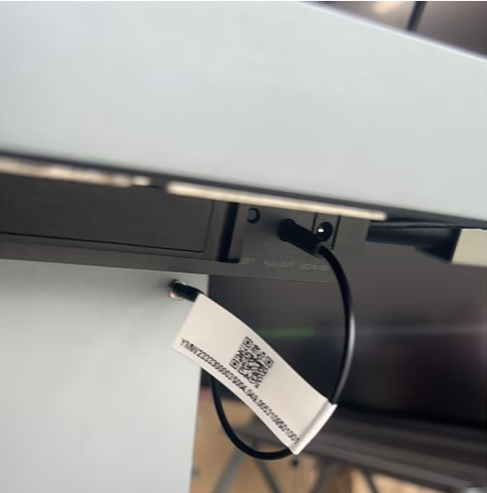
Precautions for Wire Connection:
①
When using the HDMI OUT interface on the lectern base, it is necessary to connect the HDMI adapter cable between the screen and the column. Otherwise, the HDMI OUT on the lectern base will not function。
When using the audio interface on the lectern base, it is necessary to connect the 3.5mm Audio adapter cable between the screen and the column. Otherwise, the audio interface on the lectern base will not function.
②

Slide 21
SP28-M User Manual
①
Normally the pen touching the screen is used to achieve the left-click function of the mouse.
②
Press and hold the up key and touch the screen is used to achieve the right-click function of the mouse.
③
When writing is needed, press and hold the down key is used to activate the eraser function.

Slide 22
Gooseneck microphones
When the end-user wants to purchase a gooseneck microphone to connect to the Smart Lectern for use, please refer to the following:
Interface:
Pin 1-
LED-
Gound-
MIC-
Pin 2
MIC+
Operating voltage: 1.5V 2.2K
Pin 3
LED+

Slide 23
Thanks.
www.maxhub.com
MAXHUB
sales@maxhub.com

